Slide 1
LP-IV Mini Project
“Greg Viot's Fuzzy Cruise Controller”
Group Members:
Abhishek Bhargav (41201)
Ayush Raina (41208)
Abhijeet Chavan (41216)

Slide 2
Problem Statement
Solve Greg Viot’s fuzzy cruise controller using fuzzy logic, and design a cruise control system is to maintain the speed of the car constant set by the driver using the fuzzy controller.

Slide 3
Introduction
Cruise control system has become a common feature in automobiles nowadays. Instead of having the driver frequently checking the speedometer and adjusting pressure on the gas pedal or the brake, cruise control system control the speed of the car by maintaining the constant speed set by the driver. Therefore, cruise control system can help reduce driver's fatigue in driving a long road trip.
This study presents the Greg Viot's Fuzzy control system behind a cruise control.

Slide 4
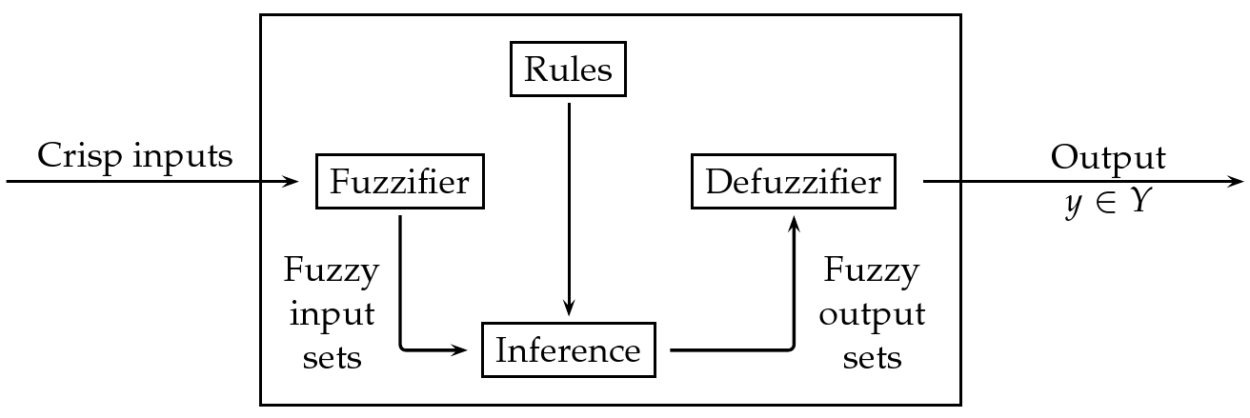
Fuzzy Inference System

Slide 5
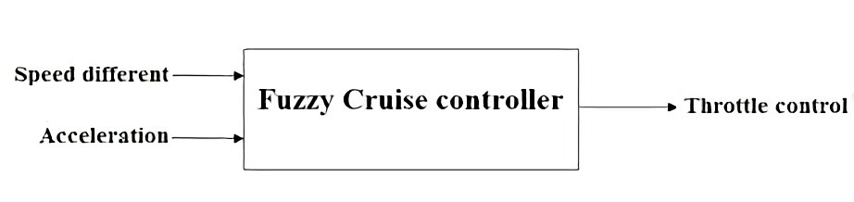
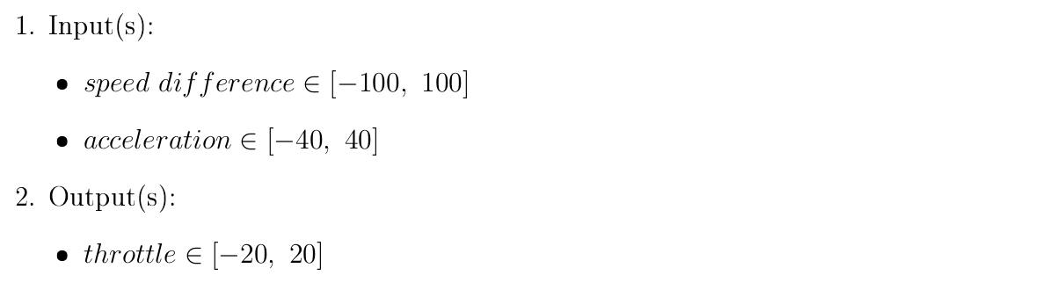
Greg Viot's fuzzy cruise controller

Slide 6
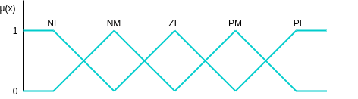
Triangular (^) MF
speed difference ∈ [−100, 100]
delta_{speed} = 50
acceleration ∈ [−40, 40]
delta_{acc} = 20
NL: Negatively Large
NM: Negatively Medium
ZE: Zero
PM: Positively Medium
PL: Positively Large

Slide 7
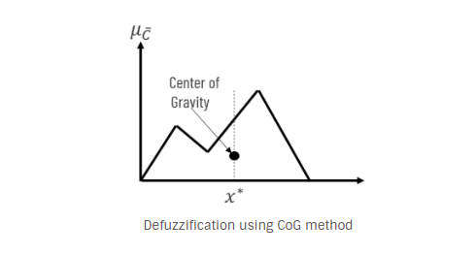
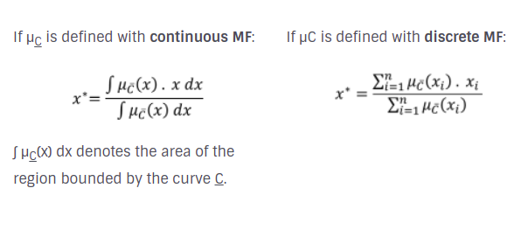
Defuzzification Method
Center of Gravity:
The basic principle in CoG method is to find the point x* where a vertical line would slice the aggregate into two equal masses.

Slide 8
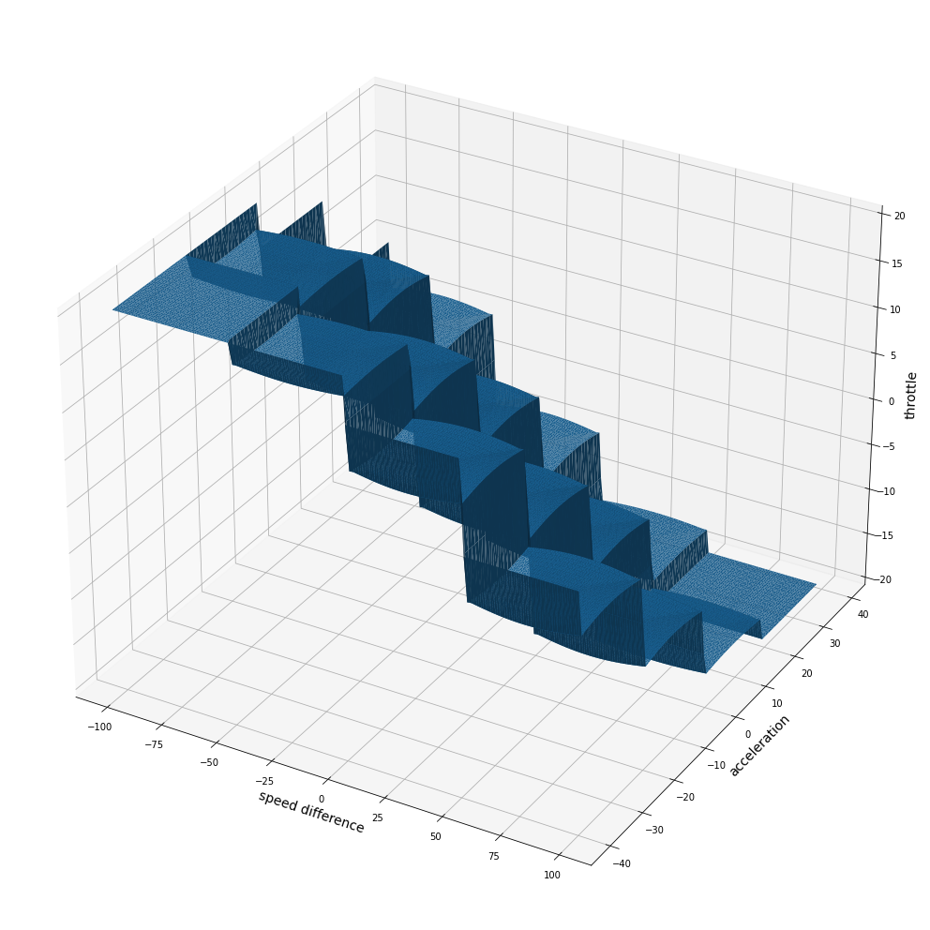
Throttle position based on speed difference, acceleration

Slide 9
Conclusion
With this study, we have demonstrated the application of fuzzy logic for designing Greg Viot's fuzzy cruise controller and observed the prediction of throttle adjustment for varying speed difference and instantaneous acceleration.

